Slide 1

CONNECT MT BROADBAND PROGRAM
TECHNICAL ASSISTANCE WEBINAR
April 19th, 2022

Slide 2
Introduction Chad Rupe
Website Chad Rupe
Challenge Process Mitch Hergett / Angie Nelson
Subrecipient Agreement Don Harris
Reimbursement Process Chad Rupe / Angie Nelson
Reporting Requirements Chad Rupe
Timeline Chad Rupe
Questions All
MORNING AGENDA

Slide 3
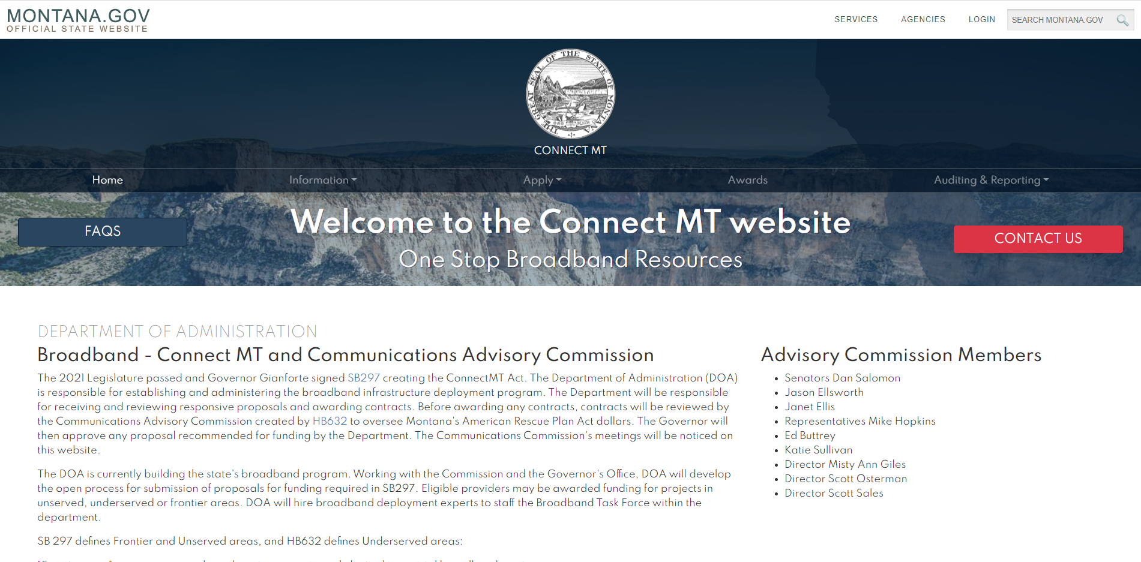
Website Orientation
https://connectmt.mt.gov/
Website includes:
FAQs
Information about the statewide broadband map, federal resources, announcements, events, webinars, forms,
and guides
Application link and guidance
Project challenge process
Awards
Auditing and reporting
Contact information

Slide 4
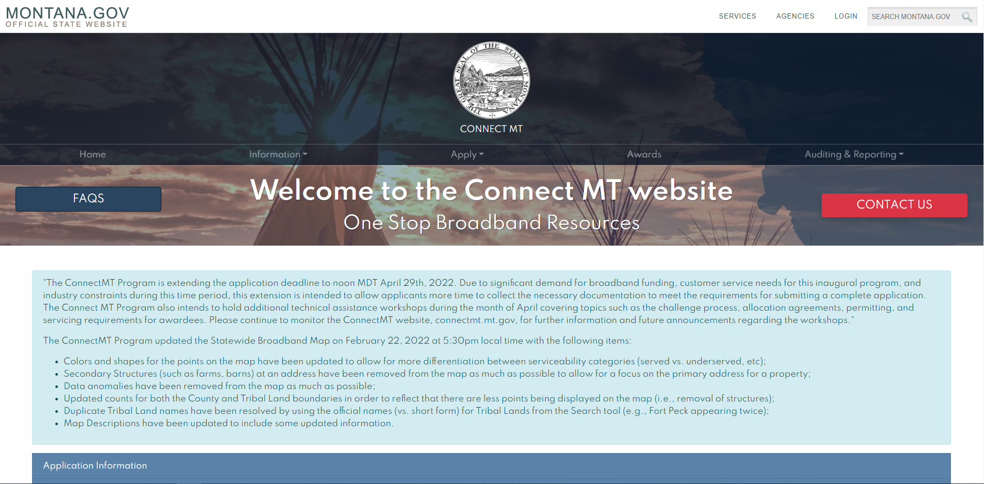
CHALLENGEAPPLICATION
https://connectmt.mt.gov/

Slide 5
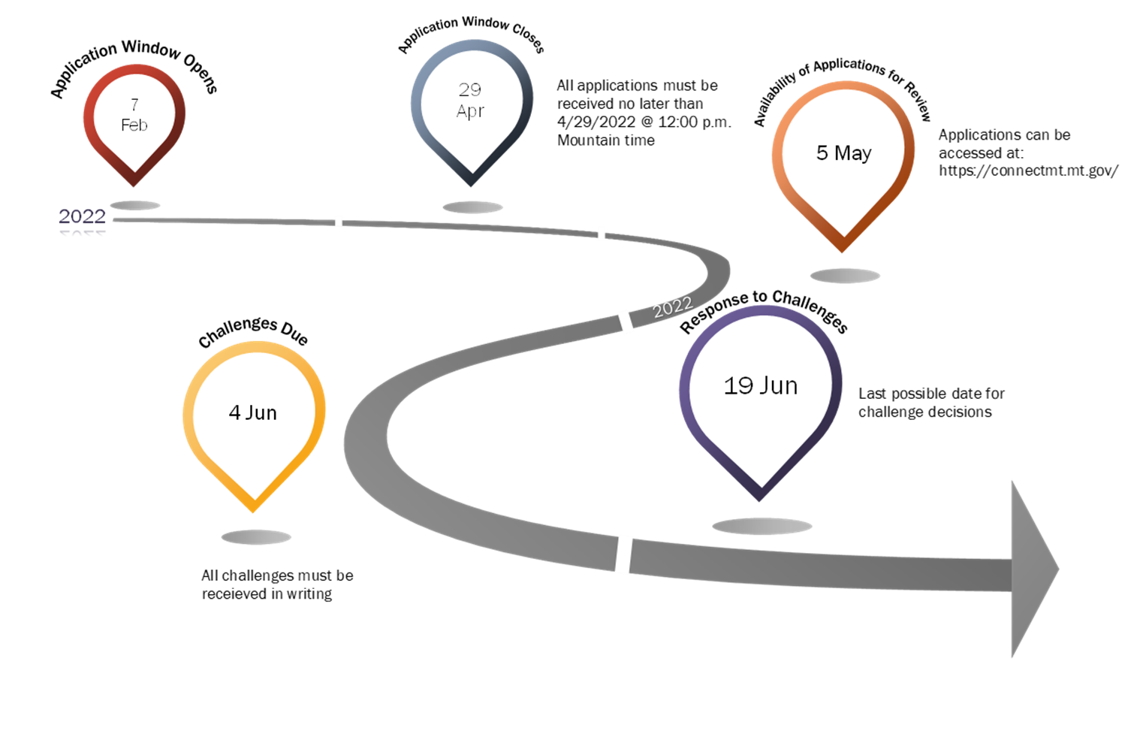
CHALLENGE
PROCESS
TIMELINE

Slide 6
CHALLENGE
PROCESS
OVERVIEW
Challengers
Challenge period opens five (5) business days after the submission window closes, applications can be viewed on the website: https://connectmt.mt.gov/
Only ConnectMT Applicants may participate in the challenge process
Challenges are due within 30 days after the release of applications
Challenges must be made through Submittable
The burden of substantiating a challenge is the responsibility of the challenger

Slide 7
CHALLENGE
PROCESS
OVERVIEW
Department of Administration (DOA)
DOA will review all submitted challenges
Within a 15-day period DOA will make a determination on whether challenge is valid
The 15-day review period will not start until DOA confirms the challenger has provided sufficient data to support their claim
Once the 15-day review period is initiated, DOA will notify the challenger and the original applicant
When required DOA will contact the challenger (or original applicant) to obtain additional information
As required DOA will perform onsite plant inspection and service validation work

Slide 8
CHALLENGE
PROCESS
OVERVIEW
Original Applicants
Where challenges are substantiated, applicants will be given the opportunity to modify their submissions
Applicants have 5 days to complete their modification and resubmission
Applicants who chose to modify their submission can request DOA to unlock their application, perform required edits, and resubmit the application

Slide 9
ANTICIPATED
CHALLENGE
SCENARIOS
It is anticipated that the majority of challenges will be tied to the following scenarios:
A challenger disputes the identified status of Serviceable Locations within an application’s proposed service area
A challenger identifies that federal funds are allocated for the deployment of broadband services (meeting or exceeding ConnectMT requirements) for Serviceable Locations within an application’s proposed service area
A challenger provides existing service (not meeting ConnectMT requirements) to Serviceable Locations within an application’s proposed service area and intends to upgrade their network to meet the necessary standards outside of the ConnectMT program
DOA has invited Montana broadband service providers to provide their service coverage area information for public use as part of developing the ConnectMT map. The window for data collection is still open!
It is expected there will be challenges not related to the scenarios above…..

Slide 10
SCENARIOS
THAT SHALL
NOT
REQUIRE A
CHALLENGE
The following scenarios would be addressed by DOA’s application review process NOT the challenge process:
Two overlapping applications proposing new service in an unserved area
An application that overlaps with served locations already identified on the ConnectMT map
The viability of an application (technical, financial, etc..)

Slide 11
CHALLENGE
SUBMISSION
SUPPORT
INFORMATION
Substantiating a challenge is the responsibility of the challenger
Challenges will be uploaded via Submittable.
Challenges based on existing broadband infrastructure must at least include:
A general narrative describing the details of the challenge including but not limited to the following:
  What areas are being challenged
  Why the area(s) are being challenged
  Description of the services offered by the challenger
GIS file showing the area(s) being challenged
A list of locations served by the challenger in the challenged area
A suitable sample of speed test data (collected from the CO)
As-built documentation of the Challenger’s existing infrastructure
  PDF and/or GIS format

Slide 12
CHALLENGE
SUBMISSION
SUPPORT
INFORMATION
Challenges based on a commitment to the Federal Government, must include at a minimum:
A narrative describing the details of the challenge, including:
  What areas are being challenged
  Why the area(s) are being challenged
  Description of the services committed by the challenger
  A detailed timeline for deployment
GIS file showing the area(s) being challenged
A copy of the Federal grant application submission
Documentation showing the challenger’s successful award and commitment to provide broadband service
A commitment letter to the State of Montana that shows the Challenger will meet the technical parameters of this program
As-built documentation (or other forms) that show the Challenger is meeting commitments

Slide 13
CHALLENGE
REVIEW AND
VALIDATION
For each challenge, DOA will perform a desk review of all provided challenge support documentation
DOA will contact the challenger for additional information or clarification as required
If necessary, the challenger will be required to participate in a field survey providing access and support to the DOA staff
The challenger may be required to assist the DOA with validation tasks, such as:
On-site field inspection of the challenger’s infrastructure to verify submitted as-built documentation
On-site testing of the challenger network to verify submitted performance testing

Slide 14
SUBRECIPIENT AGREEMENT
The Subrecipient shall comply with any U.S. Department of the Treasury or additional the Department reporting requirements necessary to comply with Connect Montana Act and ARPA.
Penalties
  All penalties are limited to 100% of the allocation to the awardee under the
  ConnectMT Program's terms of agreement.
  The department may impose upon the awardee a penalty of up to 100% of the construction costs directly assignable to each identified service location
  (as defined by the following formula: total allocation / # of proposed locations)
  that fails to complete construction as agreed in the award.
  The department may impose upon the awardee a penalty of up to 100% the
  construction costs directly assignable for each completed buildout service location
  (as defined by the following formula: total allocation / # of proposed locations)
  that fails compliance review as a result of the following:
  Delivery speed (minimum download and upload with low latency).

Slide 15
SUBRECIPIENT AGREEMENT
Penalties (continued)
  Scoring chart points that were used as a basis for approval award allocation
  throughout the compliance service period as identified through departmental
  compliance reviews.
  The department shall not impose penalties until the Communications Advisory Commission makes final determination of any penalties recommended by the
  ConnectMT Program throughout the compliance period.
Force Majeure
Price Increases
  Federal awards may be taxable as income
Buy American
Permitting Compliance / Due Diligence

Slide 16
REIMBURSEMENT PROCESS
  Online Reimbursement Requests through http://www.connectmt.gov
Eligible Costs can only be incurred after the award contract is granted
    No pre-application expenses
  Monthly Pro Rata
  Department -- (15) working days to process a request for reimbursement
  Subrecipient shall provide banking information before or at the time of
  Contract execution in order to facilitate electronic funds transfer (EFT) payments.
  Department may, in addition to the remedies available at law or in this
  Contract, withhold reimbursement to the Subrecipient until such time as the Department and the Subrecipient agree on a plan to remedy the deficiency.

Slide 17
Quarterly Report
No later than thirty (30) calendar days after the end of each calendar year quarter during the period in which allocation funds are available for expenditure, the Subrecipient must submit to the Department utilizing the Department’s online reporting system, the following information:
(awaiting U.S. Treasury guidance)
In addition, the Subrecipient must provide the Department with such other reports concerning the financial condition or operation of the Subrecipient, including its Subsidiaries, as the Department may request.
REPORTING REQUIREMENTS

Slide 18
Annual Performance Report.
3 years starting the first January 31st after Project Completion, the Subrecipient must submit the following information utilizing the Department’s online reporting system:
existing network service improvements and facility upgrades, as well as new equipment and capacity enhancements that support high-speed broadband access for educational institutions, health care providers, and public safety service providers;
the estimated number of end users who are currently using or forecasted to use the new or upgraded infrastructure;
the progress towards fulfilling the objectives for which the assistance was allocated;
REPORTING REQUIREMENTS

Slide 19
Annual Performance Report (continued)
(v) the speed and average price of the most subscribed tier of the Subrecipient’s broadband service offerings in the Project’s service area; and
(vi) the average price of broadband service in the Project’s service area.
(v) Audited Financial Statements IAW federal regulatory requirements.
Annual Map Reporting
No later than thirty (30) calendar days after the end of the Calendar Year, the Subrecipient shall be required to submit annually updated Approved Project Service Area(s) maps through the Department’s online mapping tool showing the areas where construction has been completed and geospatial location of residences and businesses that are receiving new broadband service until the entire Approved Project Service Area can receive the broadband service.
REPORTING REQUIREMENTS

Slide 20
Close Out Report
(60) days after the completion of project or termination of the Award or expenditure of all Award funds, whichever event occurs last.
The close out report shall address:
(i). a comparison of actual accomplishments to the objectives set forth in the Application and the awarded project;
(ii). a description of problems, delays, or adverse conditions that occurred, or which affected the attainment of overall Project objectives, prevented the meeting of time schedules or objectives, or precluded the attainment of particular Project work elements during established time periods;
(iii). a comparison of how funds were spent against the original general budget submitted with the Department approved Application, and
(iv). a final buildout map on the Department mapping tool.
REPORTING REQUIREMENTS

Slide 21
ARPA funded ConnectMT Program Application Window Closes April 29
Publish Executive Summaries and Maps of Each Application May 5
Challenge Window May 6 – June 4
Department Review of Challenges May 6 - June 19
Department review of ARPA applications June 1-July 8
Communications Advisory Commission Reviews ARPA projects July 19
Governor’s Office Approval of ARPA Projects July 29
Update State Broadband Map to reflect ALL federal awards in MT July 30
Obligate and begin servicing $266 million in ARPA awards August
STATE PRIORITIES . . . ARPA DEPLOYMENT

Slide 22
Contact Us:
1.844.406.ARPA(2772) or visit connect.mt.gov
Misty Ann Giles, Director, Department of Administration
406.444.2460 / mistyann.giles@mt.gov
Chad Rupe, Broadband Program Manager, Department of Administration
406.444.5475 / chad.rupe@mt.gov
QUESTIONS

