Slide 1

Technical Assistance for ConnectMT ARPA Awards:
Reimbursements, Reporting, and Updated Treasury Guidance

Slide 2

AGENDA
Meet the Speakers
The Reimbursement Process
Reporting Overview
Submittable Walkthrough
Overview of Treasury Guidance Update
Questions and Answers
Department of Administration | Connectmt
2

Slide 3
MEET OUR SPEAKERS
MARIA JACKSON | Grants Contract Coordinator, ConnectMT, DOA
HEATHER MILLS | CTC Technology & Energy
RACHEL STOGNER | CTC Technology & Energy
MONA RUPANI | Ernst & Young LLP
The ConnectMT Broadband Program​ is administered by the Montana Department of Administration.​
More information is available at connectmt.mt.gov.
Department of Administration | Connectmt
3

Slide 4
The Reimbursement Request Process
Prerequisites satisfied
Prepare Required Forms/Gather Backup
Sign into Submittable
Fill out Submittable RR Form
Upload documentation and forms
Submit
Initial Review
DOA Review
Approval
Contract signed
All required paperwork submitted
State of Montana - Vendor Invoice
The application author should receive an email with instructions for access
Demonstration later in presentation
Excel Template
Backup documentation
Proof of payment
CTC admin review of documentation
Additional information may be requested
Second line review of information and documentation
Once approved, forwards for payment
Email to awardee with updated Excel File
Additional Supporting Documentation
Status of Funds/Budget Tracking
W9
204 EFT
DEQ clearance
Department of Administration | Connectmt
4

Slide 5
GENERAL POINTERS AND PRE-REQUISITES
File all required documents with DOA prior to RR submission
Ensure you file over Submittable
No email submissions!
Filing timing: Once every 30 days
Reimbursement Requests (RR’s) may be submitted with monthly and quarterly Progress Reports
RR’s may not be submitted more than every 30 days
Requests for additional documentation to support RR’s must be submitted within 10 calendar days of request from DOA
Department of Administration | Connectmt
5

Slide 6
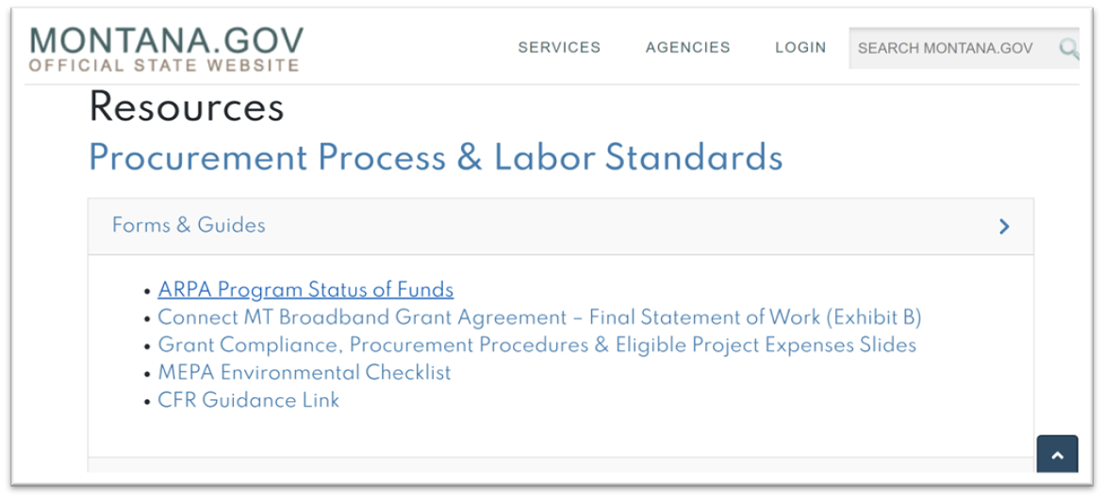
STATUS OF FUNDS: FORM WALKTHROUGH
Project Budget
  Verification/restatement of budget
Budget Tracking
  Current status of budget
  History of payments
Supporting information
  Details on invoices
Department of Administration | Connectmt
6

Slide 7
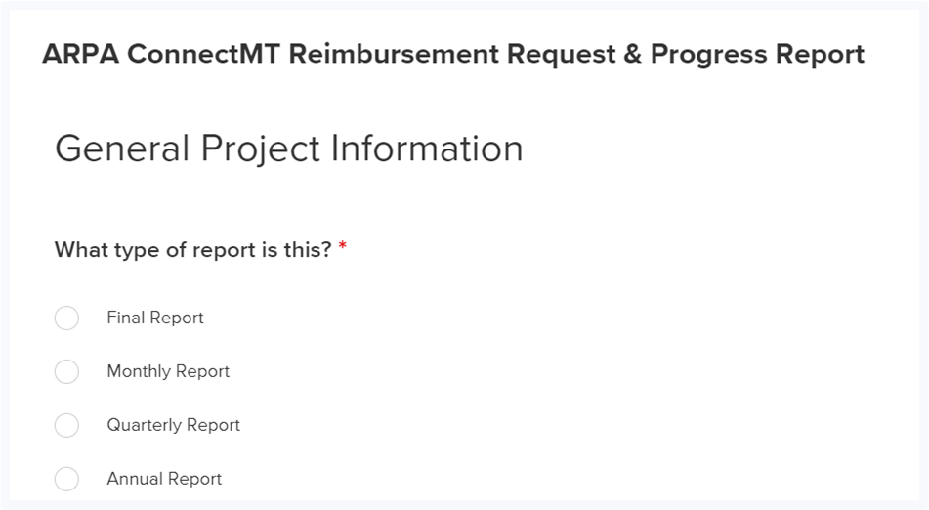
FILING RRs IN SUBMITTABLE
Log in to Submittable
Choose Report from list
During the project period, reimbursement requests are available when submitting either a monthly or quarterly report.
Department of Administration | Connectmt
7

Slide 8
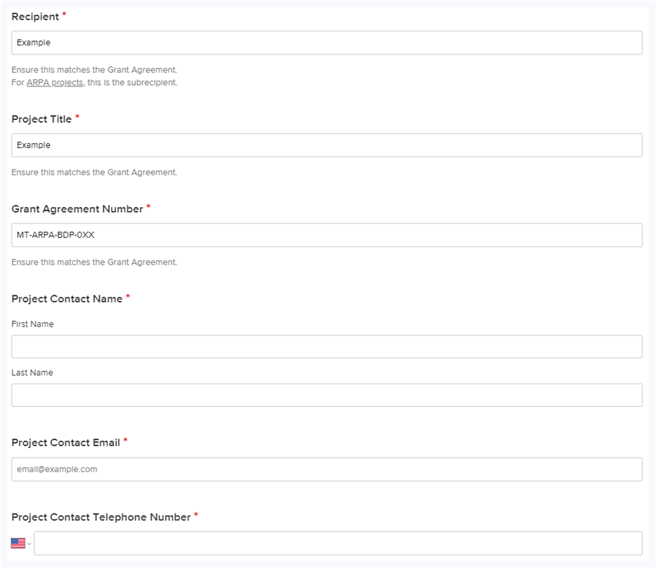
REIMBURSEMENT PROCESS OVERVIEW
Basic information about your project is required:
  Date
  Grant Recipient
  Project Title
  Grant Agreement Number (formatted MT-ARPA-BDP-0XX)
  Project Contact
    Name
    Email
    Phone Number
Department of Administration | Connectmt
8

Slide 9
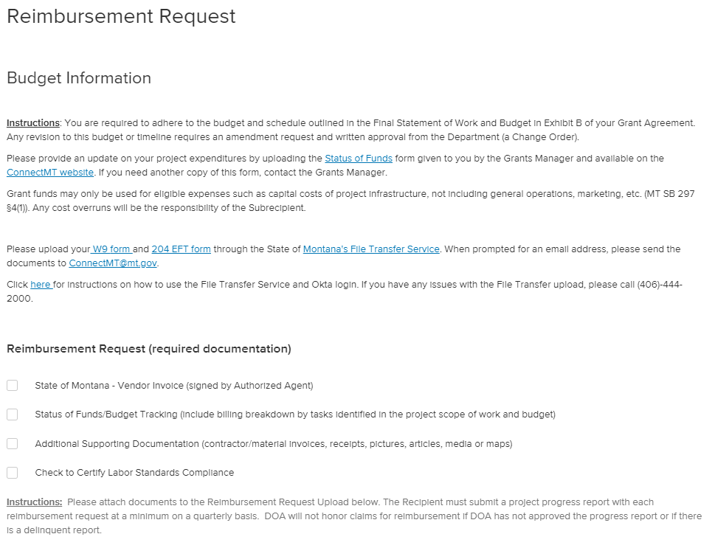
REIMBURSEMENT DOCUMENTATION
The Reimbursement Request requires the following uploads:
  State of Montana - Vendor Invoice (signed by Authorized Agent)
  Status of Funds/Budget Tracking (include billing breakdown by tasks identified in the project scope of work and budget)
  Additional Supporting Documentation (contractor/material invoices, receipts, pictures, articles, media, or maps)
Department of Administration | Connectmt
9

Slide 10
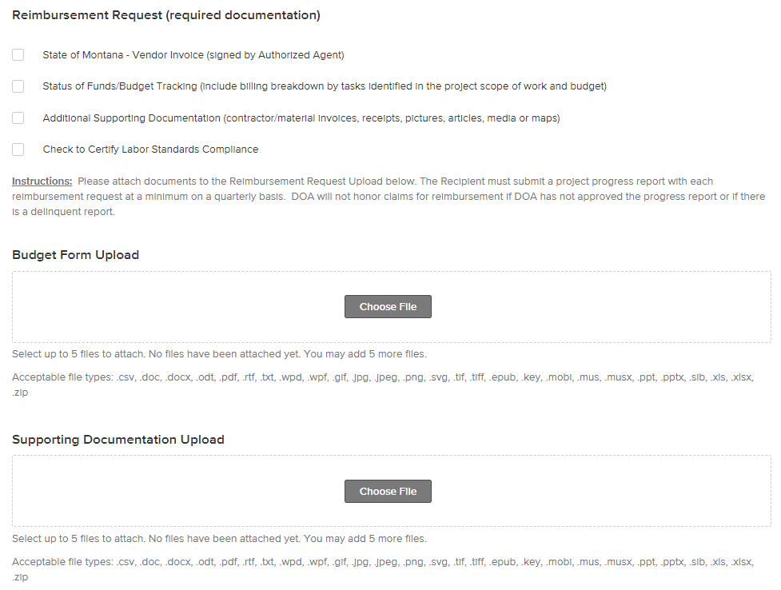
REIMBURSEMENT REQUIREMENTS
Awardees are required to:
  Select a checkbox that certifies labor standards compliance.
  Adhere to the budget and schedule outlined in the Final Statement of Work and Budget in Exhibit B of the Grant Agreement.
    Any revision to this budget or timeline requires an amendment request and written approval from DOA (a Change Order).
  Upload W9 form and 204 EFT forms through the State of Montana’s File Transfer Service.
Department of Administration | Connectmt
10

Slide 11
Monitoring and Reporting
Reporting Requirements
You will be required to submit ongoing reports as specified below. All reports except for the Annual Map will be submitted through Submittable
Type of Reporting | Description
Monthly Project Status Reports | Brief Project status report within seven calendar days following the end of the reporting period (E.g., January 7th, February 7th, March 7th).
Quarterly Reports | At Quarter end (excluding Q2), the Subrecipient will provide additional Project attributes as identified by Treasury within seven calendar days after quarter end (January 7th, April 7th, July 7th, and October 7th ).
Annual Report | For the 2nd Quarter, the Subrecipient will submit an annual report within seven calendar days after quarter end.
Other Performance and Financial Reporting (as requested) | The Subrecipient shall provide necessary information/reports within ten calendar days
Annual Map Reporting | The Subrecipient shall provide necessary information within thirty calendar days after the end of the Calendar Year to the Department’s Mapping vendor
Close Out Reporting | The Subrecipient shall provide necessary information within fifteen days after the completion of Project or termination of the award, whichever occurs first- but no later than September 30, 2026

Slide 12
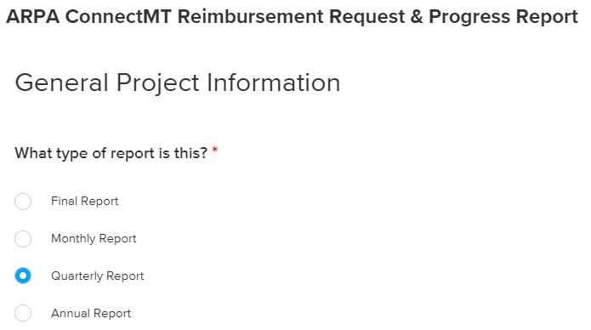
QUARTERLY REPORT OVERVIEW
Overall Project Status Updates
  Construction Start Date (Actual/Projected)
  Construction Completion Date (Actual/Projected)
  Status of Completion and Work Completion %
  Total Project Costs Incurred During the Period and Overall
  Brief Description of the Costs Incurred During The Period
Department of Administration | Connectmt
12

Slide 13
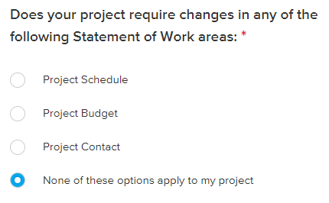
PROJECT CHANGES
Describe any changes that might significantly impact the project:
  Construction Delays
  Labor Disputes
  Supply Chain Problems
Department of Administration | Connectmt
13

Slide 14
CERTIFICATION OF
WAGES AND LABOR STANDARDS
U.S. Treasury encourages broadband projects to use strong labor standards, including project labor agreements and community benefits agreements that offer wages at or above the prevailing rate and include local hire provisions, not only to promote effective and efficient delivery of high-quality projects, but also to support the economic recovery through strong employment opportunities for workers.
As stated in Exhibit D of Grant Agreement, Grant awards above $5 million will report:
  Davis-Bacon Act Certification OR alternative wage data
  Project Labor Agreement OR Project Workforce Continuity Plan
  Prioritization of Local Hires
  Community Benefit Agreement
Department of Administration | Connectmt
14

Slide 15
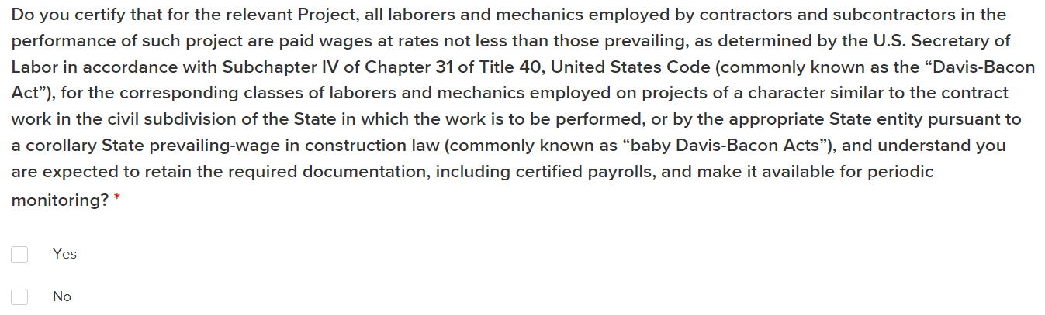
PART 1: DAVIS-BACON CERTIFICATION
Department of Administration | Connectmt
15

Slide 16
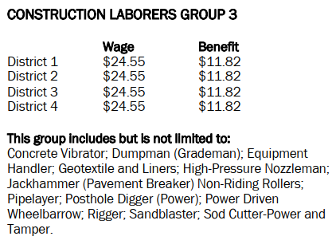
PART 1: ALTERNATIVE WAGE DATA
Subrecipients that do not certify compliance with Davis-Bacon Requirements will need to report the following:
  Number of direct employees
  Number of contractor employees
  Number of 3rd part employees
  Wages and benefits of workers on the project by classification
  Whether or not those wages are less than the prevailing wages
The Montana Department of Labor & Industry publishes prevailing wage rates on their website (https://erd.dli.mt.gov). An example is included below:
Department of Administration | Connectmt
16

Slide 17
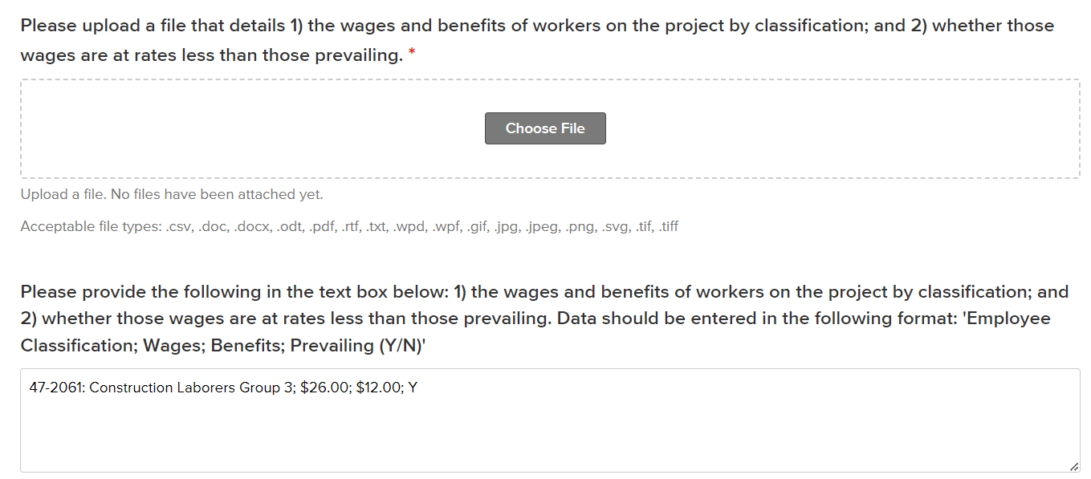
PART 1: ALTERNATIVE WAGE DATA
Department of Administration | Connectmt
17

Slide 18
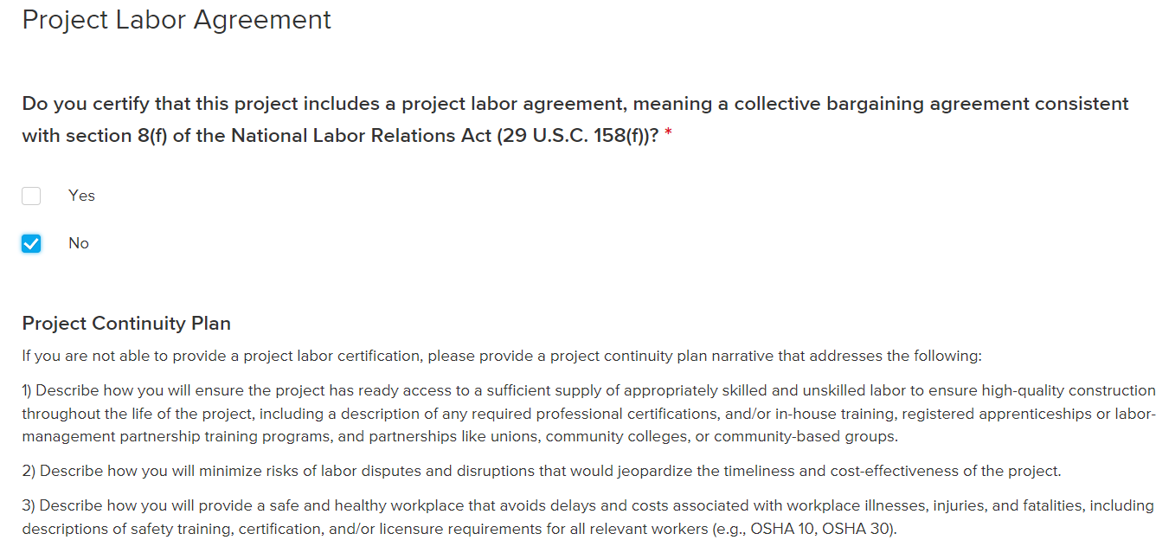
PART 2: PROJECT LABOR AGREEMENT
Department of Administration | Connectmt
18

Slide 19
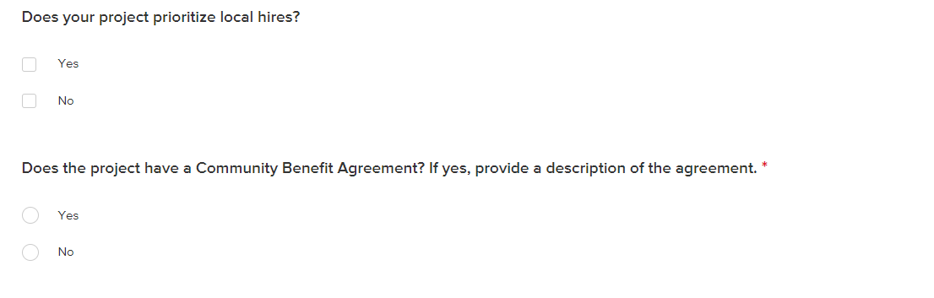
Part 3 AND 4:
LOCAL HIRES AND COMMUNITY BENEFIT
Department of Administration | Connectmt
19

Slide 20
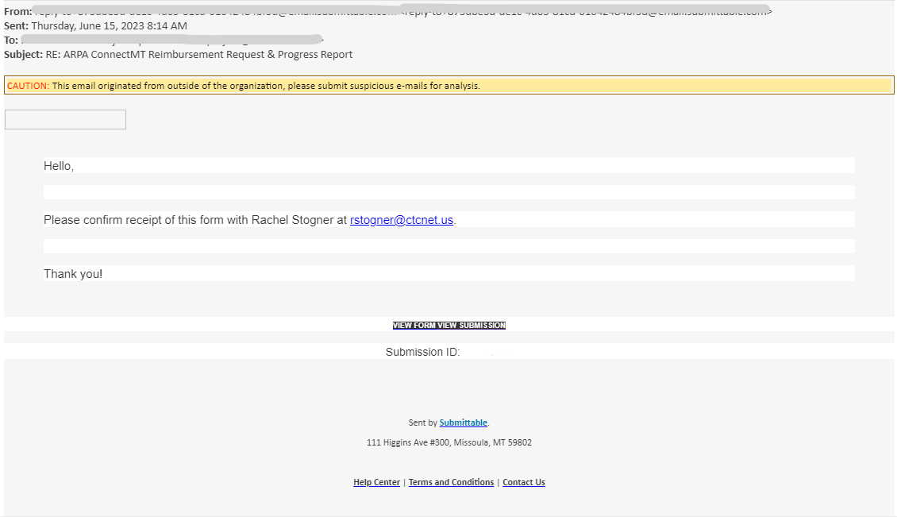
SUBMITTABLE WALKTHROUGH
Accessing the Reporting Form:
  The Application Author and any Collaborators will receive an email from the st-of-montana-message-support@submittable.com email with a link to "View Form"
  If you do not receive this link, please contact Rachel Stogner at rstogner@ctcnet.us for support
    Please also check your spam filter
Department of Administration | Connectmt
20

Slide 21
TREASURY SUPPLEMENTARY
BROADBAND GUIDANCE
Background: On May 17, 2023, Treasury provided additional guidance for Broadband Grants funded by The Coronavirus State and Local Fiscal Recovery Funds (SLFRF) program and the Capital Project Fund (CPF). The supplementary guidance includes several important clarifications and updates to the requirements for both ISPs and the state of Montana.
Key changes impacting ConnectMT awardees:
Procurement flexibility: “ISPs that receive fixed amount subawards …. are not required to comply with the cost principles and procurement practices of the Uniform Guidance.”
Extension of service obligations and subsidy participation: Service must be maintained and ISPs must participate in federal broadband service subsidy programs until December 31, 2034.
Clarification on real property and equipment standards: Treasury clarified administrative requirements applicable to property and equipment acquired with ConnectMT funds, including insurance, recording title, transfer and disposal requirements
Next Steps: The ConnectMT team will work with ISPs to make the necessary amendments to existing grant agreements.
Department of Administration | Connectmt
21

Slide 22

APPENDIX – ADDITIONAL RESOURCES
ConnectMT ARPA
Audit Requirements
Additional Grant Agreement Terms & Conditions
Record Retention
Department of Administration | connectmt

Slide 23
Audit Requirements
In each year that you expend $750,000 or more, you will provide the Department:
A financial related audit for the Project in accordance with Generally Accepted Government Auditing Standards OR
A Project specific audit in accordance with the requirements of 2 CFR §200.507
Subrecipient will provide the Department a copy of the Audit within 30 calendar days after receipt of the audit report or nine months after the end of the audit period.
Additionally, Subrecipient must allow the Department and any authorized auditors access to the Subrecipient’s records and financial statements as necessary for the Department to meet its requirements of 2 CFR Part 200.
Department of Administration | Connectmt
23

Slide 24
Grant Agreement Terms & Conditions
Service Obligation
You must manage and operate the Project in an efficient and economic manner, including maintain the Project in good repair at the level of broadband service provided in the Grant Agreement through December 31, 2034.
ACP Participation
You must participate in the Affordable Connectivity Program, or its successor through December 31, 2034.
Factors impacting selection
Some Projects were selected based on points awarded for commitments made in the Application. You must continue to comply with these commitments outlined in your Final Statement of Work.
Department of Administration | Connectmt
24

Slide 25
Record Retention
Financial records, supporting documents, statistical records, and all other Subrecipient records that are pertinent to a Federal award must be retained (2 C.F.R. 200.334)
The Subrecipient will maintain appropriate and adequate records showing complete entries of all receipts, disbursements, and other transactions relating to the project for a period of eight years from the date of the Final required ARPA Report (April 30, 2027, for CSFRF and March 31, 2027, for CPF).
Department of Administration | Connectmt
25

Slide 26
QUESTIONS?
Please type your questions in the chat box
Department of Administration | Connectmt
26

Slide 27
Thank you!
NEED HELP?
For Reporting Questions, please contact Maria Jackson at connectmt@mt.gov
For Technical Support, please contact Rachel Stogner at ConnectMTInfoRequests@ctcnet.us
Department of Administration | Connectmt
27

