Slide 1
ConnectMT Grant Compliance Webinars
GRANT COMPLIANCE, PROCUREMENT PROCEDURES, & ELIGIBLE PORJECTS EXPENSES
Notes:
[Misty Ann Giles]

Slide 2
CONNECTMT TEAM INTRODUCTIONS
Russ Katherman, Administrator
Moriah Keller, Broadband Program Coordinator
Moriah.Keller@mt.gov 406.444.4099
Maria Jackson, Grants Contracts Coordinator
Maria.Jackson2@mt.gov 406.444.3393
CTC Technology & Energy
ConnectMTInfoRequests@ctcnet.us

Slide 3
OVERVIEW
YOU ARE HERE
Grant Award Approved
Grant Agreement Signed
Pre-Development Activities
Network Build/Equipment Deployment
Network Testing
Closeout Request
Project Operations
Procurement
Incur eligible expenses
Submit requests for reimbursement
ConnectMT Required Reporting
Department of Administration | connectmt grant compliance
3

Slide 4
Federal procurement requirements
Introduction
General Procurement
Competition
Procurement Methods
Noncompetitive Procurement Methods
Contract Cost or Price
Socioeconomic Contracting
Domestic Preferences
Build America, Buy America
Bonding Requirements
Contract Provisions
Review

Slide 5
introduction
The ConnectMT program is funded by FEDERAL FUNDS
American Rescue Plan Act (ARPA) Coronavirus State Fiscal Recovery Funds (CSFRF)
ARPA Coronavirus Capital Project Funds (CPF)
The State of Montana is known as the “recipient” of the funding and is responsible for disbursing, monitoring, and providing oversight of the grant to the subrecipient.
You (Internet Service Providers) are the “subrecipient” whom the funds are distributed to and used for a specific purpose.
Please be aware that you will be considered a subrecipient and will not have the ability to subaward any part of the funds that you receive from the recipient.
As a subrecipient, anyone you engage with to build, will be a contractor.
Both the State of Montana and Internet Service Providers are REQUIRED to comply with 2 CFR 200 and terms and conditions outlined by Treasury.
All funding is subject to reporting and potential audit.

Slide 6
General procurement
Key action items:
Develop and follow written procurement policies and procedures
Incorporate Federal and applicable State requirements
Develop written standards of conduct for your project employees
Address conflicts of interest related to the award and administration of contracts
Outline incident reporting protocols and disciplinary actions that may apply
Maintain records sufficient to detail the history of procurement
Maintain oversight to ensure contractors perform in accordance with terms
Avoid use of time and materials type contracts. If required;
Establish a ceiling the contractor exceeds at its own risk
Assert a high degree of oversight
Consider leveraging value engineering
As a subrecipient of federal funds, you must follow 2 CFR 200.318.

Slide 7
Key relevant provisions
PROCUREMENT STANDARDS
Competition – 2 C.F.R. 200.319
All procurement transactions using “full and open competition”
Must have written selection procedures
Must clearly identify all bidding requirements
Restrictions on Competition
Requiring unnecessary experience or requirements
Excessive bonding requirements
Specifying only a brand name product
Noncompetitive pricing practices
Organizational conflicts of interest
Noncompetitive contracts to contracts on retainer
Any arbitrary action in the procurement process

Slide 8
Key relevant provisions
PROCUREMENT STANDARDS
Procurement Methods – 2 C.F.R. 200.320
Subrecipients must use one of the following five methods of procurement:
Procurement Thresholds
Micro Purchase
<$10K
Small Purchase
$10K - $250K
Sealed Bidding
>$250K
Competitive Proposals
>$250K
Noncompetitive
Rare
Price-focused contract
Contract not based exclusively on price
Notes:
*Procurement thresholds in place at the time of ARPA (i.e. March 2021).

Slide 9
Key relevant provisions
PROCUREMENT STANDARDS
Noncompetitive Procurement Methods – 2 C.F.R. 200.320
In limited circumstances it may be necessary to use noncompetitive procurement. To use this method, you must meet one of the following requirements:
Good or service does not exceed the micro-purchase threshold
Good or service is only available from single source
The public exigency or emergency for the good or service will not delay from a competitive solicitation
Federal awarding agency or pass-through authorizes a non-competitive procurement
After solicitation, competition is determined inadequate
Exigent Circumstances
Need to avoid, prevent, or alleviate serious harm or injury, financial or otherwise AND
Use of competitive procurement proposals would prevent the urgent action
Emergency Circumstances
Threat to life, public health or safety, or improved property
Generally short-lived

Slide 10
Key relevant provisions
PROCUREMENT STANDARDS
Noncompetitive Procurement Methods – 2 C.F.R. 200.320
Proper Noncompetitive Procurement Use
Improper Noncompetitive Procurement Use
ISP has publicly solicited proposals, received limited responses and documented other attempts to solicit additional proposals
Severe weather impacts Project area requiring materials to be purchased to protect the Project in the short-term.
ISP chooses to sole-source in order to purchase a specific brand name vendor even though comparable products are available
ISP determines exigent circumstances exist for the life of the Project due to inaccurate Project Schedule planning

Slide 11
Key relevant provisions
PROCUREMENT STANDARDS
Contract Cost or Price – 2 C.F.R. 200.324
Subrecipients must perform and document a cost or price analysis in connection with every procurement action above the simplified acquisition threshold, including contract modifications.
The cost plus a percentage of cost and percentage of construction cost methods of contracting must not be used.
Pre-Procurement
During Procurement
Independent Estimates
Price Analysis
Cost Analysis
Must make independent estimates before receiving bids or proposals as a starting point.
Example: Before receiving bids/proposals, use industry pricing benchmarks to understand where reasonable costs may fall for a project, so that during procurement process, an entity can make knowledgeable decisions
Examination and evaluation of total amount of proposed price without evaluating separate cost elements and proposed profit Example:
Comparing offers with competitive published price lists, published market prices, or similar indexes
Comparing proposed prices with prices of the same or similar items obtained through market research
Review and evaluation of separate cost elements or line items (such as labor hours, overhead, materials, etc.) and proposed profit in a proposal to determine a fair and reasonable price for a contract Example:
Verification and evaluation of the cost elements that make up the total price
Comparison of costs proposed by contractors

Slide 12
Key relevant provisions
PROCUREMENT STANDARDS
Socioeconomic Contracting – 2 C.F.R. 200.321
Recipients must take all necessary affirmative steps to assure that minority businesses, women’s business enterprises, and labor surplus area firms are used when possible.
Affirmative steps:
Placing qualified businesses on solicitation lists
Assuring that businesses are solicited whenever they are potential sources.
Dividing requirements, when economically feasible, into smaller tasks or quantities to permit maximum participation by businesses
Establishing delivery schedules which encourage participation by businesses
Use services and assistance of such organizations as the Small Business Administration and the Minority Business Development Agency of the Department of Commerce or Montana Department of Transportation DBE/SBE Directory
Require the prime contractor (if subcontractors are anticipated) to take the five previous steps

Slide 13
Key relevant provisions
PROCUREMENT STANDARDS
Domestic Preferences – 2 C.F.R. 200.322
The requirement of this section must be included in all subawards including all contracts and purchase orders for work or products under this award.
To the greatest extent practicable under a Federal award, Subrecipients should provide a preference for the purchase, acquisition, or use of goods, products or materials produced in the United States (including but not limited to iron, aluminum, steel, cement, and other manufactured products).

Slide 14
Build America, buy america
What is Build America, Buy America?
Passed as part of the Infrastructure Investment and Jobs Act
Requires the use of Made in America content
Applies to federal financial assistance programs for infrastructure whether those programs received funding from the Infrastructure Investment and Jobs Act or not
Requirements
All iron and steel items used in covered projects must be produced in the USA
All manufactured products used in covered projects must be produced in the USA
All construction materials used in covered projects must be manufactured in the USA
Adhering to Build America, Buy America standards is REQUIRED as part of the ConnectMT Program.

Slide 15
Key relevant provisions
PROCUREMENT STANDARDS
Bonding Requirements – 2 C.F.R. 200.326
Subrecipients must follow certain federal bonding rules when awarding construction or facility improvement contracts and subcontracts exceeding the simplified acquisition threshold.
Construction or facility improvement projects above $250,000 require:
A bid guarantee from each bidder equivalent to 5% of the bid price
A performance and payment bond on the part of the contractor for 100% of the contract price
$250,000
Below $250,000, subrecipients may follow its own bonding requirements, provided the requirements do not restrict competition

Slide 16
Key relevant provisions
PROCUREMENT STANDARDS
Contract Provisions – 2 C.F.R. 200.327
Administrative, contractual, or legal remedies | Contracts for more than the Simplified Acquisition Threshold
Termination for Cause and Convenience | Contracts in excess of $10,000
Davis-Bacon Act | If you are certifying compliance with Davis-Bacon Act, must be included in all construction contracts greater than $2,000
Copeland “Anti-Kickback” | Construction contracts in excess of $2,000
Contract Work Hours and Safety Standards Act | Contracts awarded in excess of $100,000 involving the employment of mechanics or laborers
Clean Air Act and the Federal Water Pollution Control Act | Contracts of amounts in excess of $150,000
Debarment and Suspension | All contracts and you should retain a copy of the Debarment search performed prior to contract effective date
Equal Employment Opportunity | All contracts
Right to Inventions | All contracts if participating in experimental, developmental, or research work
Byrd Anti-Lobbying Amendment | Contracts awarded in excess of $100,000 and include separate certification

Slide 17
review
TOP 10 PROCUREMENT MISTAKES
Restricting full and open competition
Not making and documenting efforts to take all “affirmative steps” for socioeconomic contracting
Not performing detailed cost/price analysis for procurements over 250k
Not including the required contract clauses
Engaging in a sole-sourcing contract w/o documenting E/E situation
Awarding a “cost-plus-percentage-of-cost” or “percentage-of-construction-cost” contract
Continuing work under a sole-source contract after the urgent need has ended
Awarding a contract to contractors that are suspended or debarred
Awarding a “time-and-materials” contract w/o ceiling price and documentation when no other contract type is suitable
Not documenting all steps of procurement to answer questions that could arise months/years later

Slide 18
ELIGIBLE EXPENSES
Eligible Project Costs
Approved Project Budget Category
Ineligible Project Costs
Federal Cost Principles
Department of Administration | connectmt grant compliance

Slide 19
Eligible Project Costs
Subrecipients may only submit request for reimbursement of eligible project costs.
Factors impacting eligibility:
Cost must be associated with an approved Project Budget category
Cost cannot be on the list of ineligible costs identified within the grant agreement
Cost cannot be reimbursed by another source (No Duplication of Benefits)
Cost must be allowable and reasonable as defined by federal requirements
Cost must be procured consistent with federal procurement requirements
Cost must be supported in accordance with the ConnectMT Request for Reimbursement procedures

Slide 20
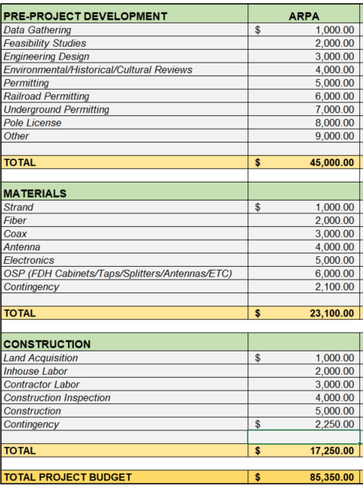
Approved Project Budget Category
Costs submitted for reimbursement must be mapped to an eligible cost category within the Project Budget
Funds must be available in the Project Budget line item to receive reimbursement
When you identify a cost overrun, you must submit a revised budget immediately for the Department’s review and approval
You will be responsible for all cost overruns
The State of Montana will not increase a Grant Award

Slide 21
ineligible Project Costs
The following costs are ineligible and will not be reimbursed under any circumstances:
Costs incurred prior to the Grant Agreement effective date [date signed by all parties]
Costs related to infrastructure outside the Project area
Short-term operating leases
Acquisition of spectrum licenses
Debt costs, including Interest or Principal payments on outstanding debt and fees or issuance costs associated with new debt
Satisfaction of any obligation pursuant to a settlement agreement, judgement, consent decree or judicially confirmed debt restructuring plan in a legal proceeding
To support or oppose collective bargaining
Operating expenses, including grant administrative, indirect, audit and ancillary costs to operationalize the capital assets
Ineligible costs include costs already reimbursed by another source – NO DUPLICATION OF BENEFITS
Department of Administration | connectmt grant compliance

Slide 22
Federal Cost Principles
Cost Principles – 2 C.F.R. 200.403-404
2 C.F.R. 200.403 Factors affecting allowability of costs
2 C.F.R. 200.404 Reasonable costs
2 C.F.R. 200.403 Factors affecting allowability of costs
2 C.F.R. 200.404 Reasonable costs
Costs must meet the following criteria:
Be necessary and reasonable
Conform to limitations or exclusions
Be consistent with policies and procedures
Be in accordance with GAAP
Not be included as a cost of any other federally financed program
Be adequately documented
Cost is reasonable if it does not exceed that which would be incurred by a prudent person under the circumstances prevailing at the time the decision was made to incur the cost.

Slide 23
APPENDIX – ADDITIONAL RESOURCES
ConnectMT ARPA
Federal Funding Key Relevant Provisions
Required Business Registrations
Department of Administration | connectmt grant compliance

Slide 24
Key relevant provisions
FEDERAL FUNDING
2 C.F.R. 200 Key Relevant Provisions
200.317-327 Procurement Standards | 200.328-329 Performance and Financial Monitoring and Reporting
2 C.F.R. 200.317 Procurement by States | 2 C.F.R. 200.328 Financial Reporting
2 C.F.R. 200.318 General Procurement Standards | 2 C.F.R. 200.329 Monitoring and Reporting Program Performance
2 C.F.R. 200.319 Competition | 200.331-333 Subrecipient Monitoring and Management
2 C.F.R. 200.320 Methods of Procurement to be Followed | 2 C.F.R. 200.331 Subrecipient and Contractor Determinations
2 C.F.R. 200.321 Socioeconomic Contracting | 2 C.F.R. 200.332 Requirements for pass-through entities
2 C.F.R. 200.322 Domestic Preferences | 200.402-411 Cost Principles Basic Considerations
2 C.F.R. 200.323 Recovered Materials | 2 C.F.R. 200.403 Factors affecting allowability of costs
2 C.F.R. 200.324 Contract Cost and Price | 2 C.F.R. 200.404 Reasonable costs
2 C.F.R. 200.325 Review of Procurement | 200.501 – Audit Requirements
2 C.F.R, 200.326 Bonding Requirements | 2 C.F.R. 200.501
2 C.F.R. 200.327 Contract Provisions

Slide 25
REQUIRED BUSINESS REGISTRATIONS
Required Business Registrations
SAM.gov Registration
Montana Secretary of State Business Registration
Department of Administration | connectmt grant compliance

Slide 26
Required Business Registrations
2 C.F.R. 200.214 Suspension and Debarment
Secretary of State Business Registration
Subrecipients are subject to the non-procurement debarment and suspension regulations implementing Executive Orders 12549 and 12689, 2 CFR part 180
2 CFE part 180: restrict awards, subawards, and contracts with certain parties that are debarred, suspended, or otherwise excluded from or ineligible for participation in Federal assistance programs or activities
Any business intending to transact business in Montana must register with the Secretary of State
Businesses that are incorporated in another state or country, but which are conducting activity in Montana, must determine whether they are transacting business in Montana in accordance with the laws of the State of Montana
Out of state business must obtain a certificate of authority from the Secretary of State to demonstrate they are in good standing in Montana

Slide 27
SAM.gov Registration
Click here to register on SAM.gov
You must register for a SAM.gov account. As part of your registration, you will obtain a 12-digit Unique Entity Identifier (UEI). Keep track of this number.
Note: This step can take some time - plan ahead. The website says it takes 10 business days, but it can take up to several weeks. Start early!

Slide 28
SAM.gov Registration
Already Registered?
If you are already registered with SAM.gov, confirm your registration status is Active. Revisit the registration annually to maintain good standing.
Excluded, Suspended or Debarred Status
If your organization status is noted as excluded (also referred to as suspensions or debarments), contact the Department immediately. Per 2 CFR 180, your organization may be excluded from receiving federal contracts, certain subcontracts, and certain types of federal financial and non-financial assistance and benefits.
SAM.gov Registration
The following information will be needed for registration:
Federal EIN (i.e., TIN, Tax Identification Number)
Review tax documents from the IRS (specifically the Form 1099) to find exact taxpayer name
Unique Entity Identifier (UEI) number (assigned during registration process, if needed)
Legal business name
Business Address
Bank routing number, account number, and account type are needed to set up the electronic funds transfer

Slide 29
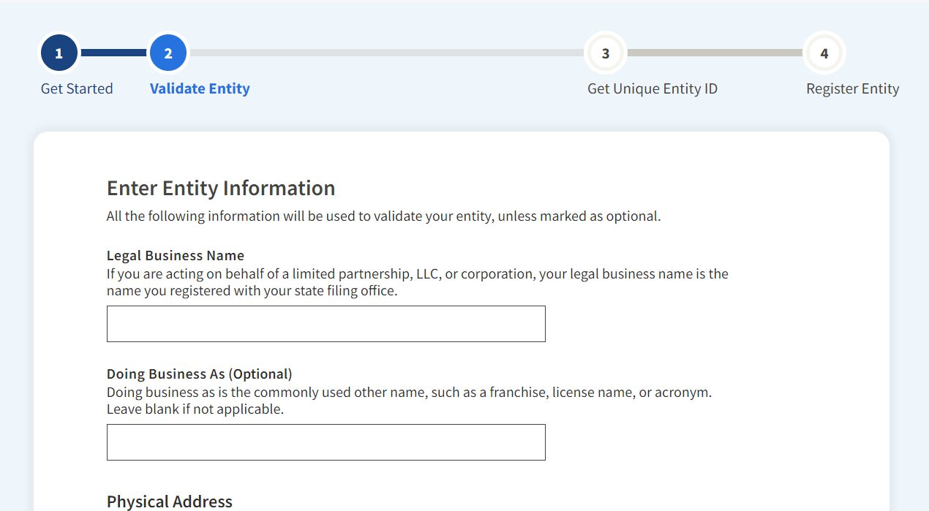
SAM.gov Registration
Unique Entity Identifier
Select your purpose for registration as, “Financial Assistance Awards,” and indicate if you are registering a Government Entity.
Validate your Entity by entering the following information:
Legal Business Name
Physical Address (no P.O. boxes or virtual offices)
Date of Incorporation
State of Incorporation (U.S. entities only)
Your organization name and address will be validated by SAM.gov. If SAM.gov cannot automatically validate your organization, the system may request you provide an official document, such as Certified Articles of Incorporation.
You will also select whether you want your organization to be visible in public search results. For Pre-Qualification, your SAM.gov account must be set to public until after you are registered in the GATA Grantee Portal.
If your account is set to private, the system will not be able to sync your accounts.

Slide 30
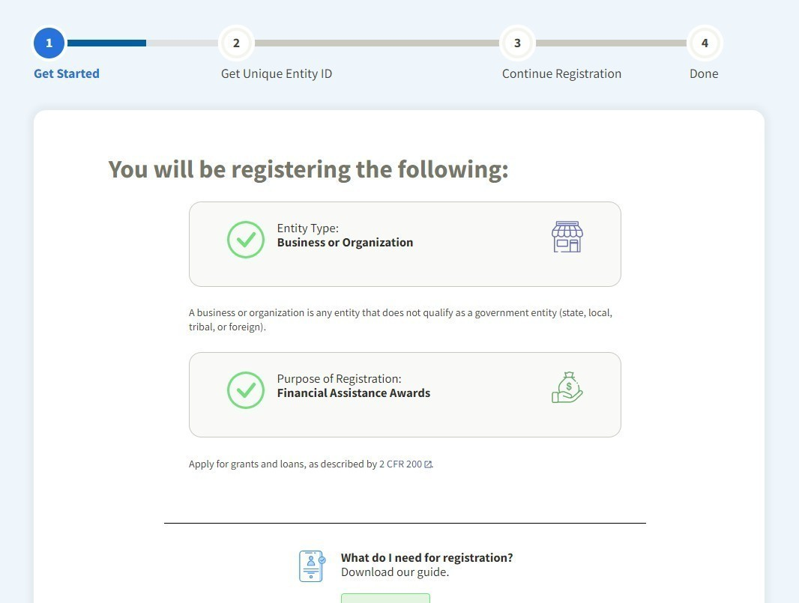
SAM.gov Registration
Core Data
After receiving a UEI, you will need to enter the following “Core Data” to finish your SAM.gov registration:
Business Information
Organization start date
Date on which your company’s fiscal year ends
(Optional) Organization’s division name and number
(Optional) Organization’s website URL
Marketing Partner Identification Number (MPIN) (created at registration)
Physical and mailing address
Taxpayer Identification Number (TIN) (U.S. entities only)
IRS Consent
IRS Consent Form (taxpayer name and address)
CAGE Code (U.S. entities only) (If you do not have a CAGE code, select “No”)

Slide 31
SAM.gov Registration
Core Data - General Information
Country of Incorporation
State of Incorporation (U.S. entities only)
(Optional) Company Security Clearance
(Optional) Highest Employee Security Clearance Level
(If applicable) Institution Type (e.g., foundation, hospital, educational)
(If applicable) Disadvantaged Business Enterprise (must be certified by a federal agency)
(If applicable) Native American Organization Type
Organization Factors (e.g., S corporation, LLC, foreign-owned)
Organization Structure (e.g., Corporate organization-Not Tax Exempt, Corporate organization-Tax Exempt, Sole Proprietorship)
Profit Structure (e.g., for-profit, non-profit)
Socio-economic Categories (e.g., veteran-owned, minority-owned)

Slide 32
SAM.gov Registration
Core Data - Financial Information
Accept credit cards as a method of payment (yes or no)
Electronic Funds Transfer (optional for non-U.S. entities)
Account type
Routing number
Account number
Automated Clearing House
U.S. phone number
Remittance Name and Address

Slide 33
SAM.gov Registration
Core Data - Executive Compensation Questions
Answer yes if in the last fiscal year:
80% or more of your organization’s revenue come from federal sources (contracts, grants, loans, etc.)
Your total revenue from federal sources exceeded $25 million
Does the public have access to information about the compensation of the senior executives in your business or organization? (yes or no)
If yes to the first two questions and no to the third question, then provide names, titles, and total compensation values of your top five executive compensated employees.
Core Data - Proceedings Questions
If you answer “yes” to each of the below three questions, see page 14 of the SAM.gov Organization Registration Checklist for additional required questions:
Is your organization responding to a federal procurement opportunity that contains the provision within FAR 52.209-7?
Is your organization subject to the clause within FAR 52.209-9 in any current federal contracts?
Is your organization applying for a federal grant opportunity that contains the award term and condition described in C.F.R. 200 Appendix XII?

Slide 34
SAM.gov Registration
Once you have entered the core data, you will have to answer the following:
Representations and Certifications include the following information:
Does your organization wish to apply for federal financial assistance project or program or is your organization currently a recipient of funding under a federal financial assistance project or program? (yes or no)
If yes, the financial assistance representations and certifications will display. You must read and certify your organization attests to the accuracy of the representations and certifications listed. See the SAM.gov organization Registration Checklist, Appendix I (page 16 of 18) to review the financial assistance representations and certifications.
Entry of Points of Contact (POCs):
Enter the first and last name, email, phone number, and address (if applicable) for the below Mandatory POCs:
Accounts Receivable POC
Electronic Business POC
Government Business POC
Note: For POCs, the same person can be listed in multiple roles.

Slide 35
Mt Secretary of State Registration
To Register a Business with the Secretary of State’s Office
Visit the online filing portal at https://biz.sosmt.gov/.
Sign into the site with username and password. (If new user, simply click the login button to create a new account.)
Once signed in, go to the Forms section in the left side menu.
Choose the applicable form.
Use Domestic forms if business is meant to be a Montana business.
Use Foreign forms if business was already formed in another state/country and wants to conduct business in Montana.
Fill in the form with all required fields, as designated by red asterisks. Please note scroll down each page of the form to make sure everything required has been completed. If there is a page with missing information, it will be highlighted in red with an “x” on the summary page. Click on the page with the missing information to edit.
Submit the form to the Secretary of State’s Office for processing with its required fee (payable by credit/debit card or by e-check).
It will be reviewed, and once approved, an email notification will be sent with instructions to retrieve approved documents from the portal.

Slide 36
Contact us at connectmt@mt.gov or Visit connectmt.mt.gov Moriah Keller, Program Coordinator 406.444.4099 / Moriah.Keller@mt.gov Maria Jackson, Grants Contracts Coordinator 406.444.3393 / Maria.Jackson2@mt.gov CTC Technology & Energy / ConnectMTInfoRequests@ctcnet.us
QUESTIONS?

