Slide 1
MONTANA BEAD PREQUALIFICATION
Deep Dive
February 08, 2024

Slide 2
INTRODUCTIONS
Maria Jackson - Grants Contracts Coordinator
Representing the State of Montana
maria.jackson2@mt.gov
406.444.3393
Heather Mills – Vice President, CTC
Leading Today's Presentation
hmills@ctcnet.us
Rebecca Fairchild-Lewis – Manager Summit
Moderating Today's Presentation
rebecca.fairchild-lewis@summitllc.us
Department of Administration
2

Slide 3
BEAD PROGRAM OVERVIEW
The Broadband Equity, Access, and Deployment Program (BEAD) is designed to expand high-speed internet access by funding planning, infrastructure deployment, and broadband adoption programs across the country. BEAD is administered by the National Telecommunications and Information Administration (NTIA).
The State of Montana was awarded $628 million in BEAD funding to connect all unserved locations in the state with reliable and affordable broadband
Department of Administration
3

Slide 4
BEAD PROGRAM OVERVIEW
The Montana Broadband Office (MBO) will execute the subgrantee selection process across three phases:
Map Challenge Process:
Nonprofits, ISPs, and local governments can submit challenges to the broadband map.
Prequalification:
Applicants will submit materials for prequalification to meet the BEAD minimum eligibility requirements
Main Round Application:
Once applicants submit prequalification materials, they are able to complete the main round application with project specific information.
Department of Administration
4

Slide 5
2024 PROGRAM TIMELINE
Main Round Opens
*All dates are estimated and subject to change*
Prequalification Opens
Main Round Closes
Jan 24
Feb 24
Mar 24
Apr 24
May 24
June 24
Jul 24
Aug 24
Sep 24
Oct 24
Nov 24
Dec 24
Prequalification Approval
Rebuttal Process Begins
Selection of Subrecipients
Map Challenge Process Begins
Map Challenge Adjudication Completes
Department of Administration
5

Slide 6
PREQUALIFICATION
Purpose
The purpose of the prequalification process is to evaluate the eligibility status of each intended applicant to ensure these entities have a smooth main round application process.
Enables applicants to have a smooth main round application process
Timing
The prequalification application will be available in early March
Providers who intend to apply during the main application round are strongly encouraged to submit a prequalification application.
Department of Administration
6

Slide 7
UNDERSTANDING REQUIREMENTS
Subgrantee Eligibility Requirements
To receive BEAD funding, subgrantees must:
Meet mandated financial requirements
Have provided broadband service in The State of Montana for at least 1 year
Propose a project that will provide 100/20 service to all locations within service area within 4-year timeline
Can comply with all requirements mandated by NTIA and the State of Montana
Prequalification Application Requirements
The BEAD NOFO explicitly outlines the requirements to meet the program’s minimum eligibility criteria:
Financial Capability: Certifications and documentation, Letter of credit compliance statement, Audited financial statements
Organizational Capability: Key management resumes, Organizational charts, Certification of operational readiness, Evidence of prior service, Compliance with regulatory filings
Certifications and Compliance: Adherence to federal, state, and local laws, Compliance with occupational safety regulations
Department of Administration
7

Slide 8
ADMINISTRATIVE REQUIREMENTS
The first section of the prequalification application will request basic contact details for the organizations primary contact and authorized organizational representative.
The authorized organizational representation (AOR) should be an individual who is legally able to make financial decisions and sign contracts on behalf of the company.
Department of Administration
8

Slide 9
FINANCIAL REQUIREMENTS
Financial Statements
Submission of unqualified* audited financial statements from the prior year
If the organization only has qualified** audited financial statements from the prior year, be prepared to provide those along with any documentation addressing the findings
If neither is available, provide a justification if those statements are unavailable
NOTE: Audited financial statements will be required prior to award.
Applicants will also be asked to provide interim financial statements for the current year
*Unqualified audited financial statements: audited financial statements that have no noted issues from the preparer
**Qualified audited financial statements: audited financial statements that have noted issues from the preparer
Department of Administration
9

Slide 10
FINANCIAL REQUIREMENTS
Executive Authority for Financial Capability
Be prepared to provide a statement signed by an Authorized Organizational Representative that certifies that the organization meets the minimum financial qualifications of the BEAD program.
A template will be available for use.
Letter of Credit
Be prepared to provide a statement of how the organization plans to meet the requirements for a letter of credit in alignment with the instructions published by NTIA in the waiver.
Department of Administration
10

Slide 11
ORGANIZATIONAL CAPABILITY
One of the main goals of the prequalification process is to ensure each applicant has the organizational capability to successfully manage BEAD funding.
Each applicant must provide the following related to the organizational management:
Resumes of key management personnel
Roles and responsibilities of key management personnel
Organizational chart depicting key management only
Description of organization’s prior experience with broadband projects
Information about current broadband deployment projects
Department of Administration
11

Slide 12
ORGANIZATIONAL CAPABILITY
Resumes of Key Management Personnel
One page per individual
Upload as a PDF
Include a minimum of 5 years of relevant experience
Remove any Personally Identifying Information (PII)
Roles and Responsibilities
Upload a detailed narrative outlining the organization’s managerial approach
Include roles and responsibilities of all key management personnel
Organizational Chart
Upload an organizational chart to include all relevant management personnel, including all detailed in provided resumes and narrative
Names and titles should be included for all positions
Department of Administration
12

Slide 13
ORGANIZATIONAL CAPABILITY
Prior Broadband Experience
Detail company’s scope, amount, length, and funding source for three recent broadband projects
Should also include past involvement in telecommunications deployments and projects of a similar scale
Detail methods and strategies used in handling projects of a comparable size and scope
Current Broadband Deployment Projects
Use the provided template to upload a list of all broadband deployment projects that have received or will receive public funding
Include all projects the company or its affiliates has applied for or intends to apply for
Department of Administration
13

Slide 14
CERTIFICATIONS AND COMPLIANCE
Staff Certifications and Compliance
Applicants must certify that they have employed personnel with the relevant certifications for deployment projects as mandated by state and federal law and reflective of industry best practices.
These individuals must include:
Chief Technology Officer
Project Engineer
Contractor Oversight Team
Applicants will be required to upload a list of certifications required for staff ​deployment projects. This should be organized by role.​
If the hiring of contractors is anticipated, the applicant must detail the intended resources and the relevant certifications and requirements that will be confirmed before contracting with any entity.
Department of Administration
14

Slide 15
CERTIFICATIONS AND COMPLIANCE
Environmental, Historical, and BABA Requirements
Compliance with Environmental and Historical Preservation requirements as outlined in the BEAD NOFO and the Montana Initial Proposal Volume 2
Compliance with Build America, Buy America (BABA) requirements as outlined in the BEAD NOFO and the Montana Initial Proposal Volume 2
Legal Opinion
Each applicant must upload a legal opinion that certifies they can carry out the funded activities competently and in compliance with all federal, state, and local laws
A template will be provided, but use of this template is not mandatory
Department of Administration
15

Slide 16
CERTIFICATIONS AND COMPLIANCE
Health and Safety
Certify that workers will be permitted to create worker-led health and safety committees
Prior Service and FCC Form 477
Has the company previously provided voice/broadband service in the state of Montana?
If so, confirm submission of FCC Form 477 and Broadband DATA Act as applicable
If unable to confirm, provide a justification as to how the company will comply with the Commission’s rules and regulations
Commit to participating in ACP or other programs
Business Registration
Confirm active SAM.gov registration and upload documentation
Confirm active registration with the state of Montana and upload documentation
Department of Administration
16

Slide 17
FEDERAL LABOR AND EMPLOYMENT LAW
Federal Law Compliance
Certify compliance with federal labor and employment laws on broadband development projects over the last three years
Certify that the organization, contractors, and subcontractors have consistently complied with federal labor and employment laws
Confirm that the organization has not been found to have violated laws such as OSHA, FLSA, or similar laws within the last three years
If violations have been found, detail mitigating actions taken and provide documentation
Labor and Employment Practices
Certify organization, contractors, and subcontractors have existing labor and employment practices in place and commit to annual recertification for the duration of the project
Provide narrative description of existing labor and employment practices and provide any supporting materials available
Upload documentation of applicable wage scales and wage and overtime practices by employee class
Indicate if workforce is unionized
Department of Administration
17

Slide 18
RISK MANAGEMENT
Risk Management – Cybersecurity
Confirm that the organization has a cybersecurity risk management plan compliant with NIST Framework for Improving Critical Infrastructure Cybersecurity and the requirements of Executive Order 14028.
If confirmed:
Upload a copy of the plan
Certify that the plan will be updated periodically as needed and any significant changes will be submitted to the State within 30 days
Provide a narrative detailing the expected timeline to complete plan updates
If unable to confirm:
Will the entity be able to provide a plan during the main round application?
Department of Administration
18

Slide 19
RISK MANAGEMENT
Risk Management – Supply Chain
Confirm the company has a current Supply Chain Risk Management Plan based upon the following documents:
NISTIR 8276
Key Practices in Cyber Supply Chain Risk Management: Observations from Industry
NIST 800-161, Cybersecurity Supply Chain Risk Management Practices for Systems and Organizations
Any other applicable SCRM guidance from NIST
If confirmed:
Upload a copy of the plan
Certify that the plan will be updated periodically as needed and any significant changes will be submitted to the State within 30 days
Provide a narrative detailing the expected timeline to complete plan updates
If unable to confirm:
Will the entity be able to provide a plan during the main round application?
Department of Administration
19

Slide 20
OWNERSHIP
Federal regulations require disclosure of relevant ownership information, including but not limited to
Identity and relationship of persons or entities directly or indirectly owning or controlling the applicant
Identity and amount of ownership of any party holding 10% or more of stock in the applicant
Additional specific details will be requested of limited partnerships, general partnerships, and limited liability companies
Any FCC-regulated entity or applicant for an FCC license of in which any of the applicant’s owners hold 10% or more of stock
Department of Administration
20

Slide 21
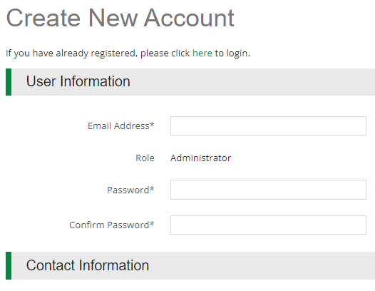
HOW TO APPLY
Application Registration
By clicking the ‘Apply’ button, applicants will be prompted to Log In or Register.
When the BEAD Application Portal (powered by Amplifund) Login screen appears, users will click the ‘Register’ button to Create New Account for their Applicant Organization. Applicants should only Register ONCE for their Organization. Users can be added to the Organization account
Navigating the Applicant Portal
Once registered and in the applicant portal, users can edit their information or add Users through the Account Information section.
User roles: Editor vs Administrator
Editor can modify application but cannot submit
Department of Administration
21

Slide 22
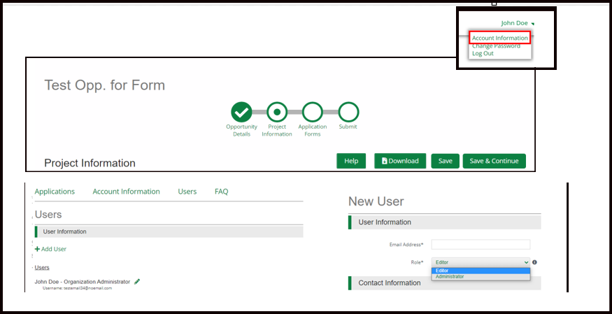
HOW TO APPLY
Completing the Prequalification Application
The Navigation toolbar provides quick access to all sections of the application. Once ‘Marked as Complete’ a checkmark will appear on the section header.
Save – Saves progress and remain on current page
Mark as Complete – Indicates the form has been completed
Save & Continue – Save progress on page and move on to next section/form
Once all sections have been Completed, a user with the Administration role can click the Submit button.
Once Submitted, applications cannot be modified.
Department of Administration
22

Slide 23
CHECKLIST FOR SUBMISSION
Materials to Prepare for Prequalification:
Identify AOR and key application contacts
Company Name, Address, TIN, Contact Information
Gather financial statements and other documentation
Identify key managerial staff, update resumes and organizational charts
Confirm active registrations with SAM.gov and the State of Montana
Identify projects of similar size and/or scope for past performance
Ensure accurate ownership documentation
Review BEAD NOFO, MT Initial Proposal Volume 2, and relevant regulations
Department of Administration
23

Slide 24
PREQUALIFICATION TIMELINE
Technical Assistance Schedule
Component | Topic | Anticipated Date | Mode
Prequalification | Deep Dive | 2/8/2024 | Webinar
Prequalification | Q/A | 2/16/24* | Webinar
Prequalification | Deep Dive | 2/29/2024* | Webinar
Prequalification | Q&A | 3/8/2023* | Webinar
*All dates are estimated and subject to change*
24
Department of Administration

Slide 25
PROGRAM CONTACTS
BEAD Program Information: https://connectmt.mt.gov
Initial Proposal Volumes 1 and 2: https://connectmt.mt.gov/IIJA/Funding
Frequently Asked Questions: https://connectmt.mt.gov/IIJA/FAQ
Technical Assistance Email: ConnectMTTechAssistance@mt.gov
Maria Jackson - Grants Contracts Coordinator
Representing the State of Montana
maria.jackson2@mt.gov
406.444.3393
Department of Administration
25

Slide 26
PREQUALIFICATION DEEP DIVE Q&A
Q&A
Department of Administration
26

